Slide 1
Tuples and Sets

Slide 2
Problem
A hospital has received a set of lab reports. Totally five tests are conducted in the lab and the report is prepared in such a way that the ‘n^{th}’ number correspond to value of test_{n} . Given the details of a test made for a patient, write an algorithm and the subsequent Python program to print if the test result is normal or not normal by referring the values in Table 1. Since the value is sensitive, provide a mechanism so that the values do not get altered.

Slide 3
Name of the Test | Minimum Value | Maximum Value
Test1 | 20 | 30
Test2 | 35.5 | 40
Test3 | 12 | 15
Test4 | 120 | 150
Test5 | 80 | 120

Slide 4
PAC For Lab Test Problem
Input | Processing | Output
Test name and a pair of values indicating the minimum and the maximum value for the five tests Name of the test and the value observed | Check if the observed value is in the range of permissible values for the test and print ‘Normal’ or ‘Abnormal’ | Print ‘Normal’ or ‘Abnormal’

Slide 5
Pseudocode LabTest Problem
FOR i =0 to 5
READ test_Name_{i}
READ minimum_{i}
READ maximum_{i}
Map test_Name_{i} to minimum_{i} and maximum_{i}
READ test_Name_Chk
READ observed_Value
END_FOR

Slide 6
IF observed_Value>min of test_Name_Chk
and observed_Value <max of test_Name_Chk
THEN
PRINT ‘Normal’
ELSE
PRINT ‘Abnormal’
END IF
Store the values such that it is not getting modified

Slide 7
We Already Know
To read values
Map a value to another - Dictionary
Print Values
Form a pair of values – List – But the values can be changed
Yet to learn about pairing values that cannot be modified

Slide 8
Tuples
Sequence of immutable Python objects
Tuples cannot be changed like lists and tuples use parentheses, whereas lists use square brackets.
Creating a tuple is as simple as putting different comma-separated values.
Optionally you can put these comma-separated values between parentheses also.

Slide 9
For example −
tup1 = ('physics', 'chemistry', 1997, 2000);
tup2 = (1, 2, 3, 4, 5 );
tup3 = "a", "b", "c", "d";

Slide 10
empty tuple −
tup1 = ();
To write a tuple containing a single value you have to include a comma −
a = (50) # an integer
tup1 = (50,); # tuple containing an integer
tuple indices start at 0

Slide 11
print ("tup1[0]: ", tup1[0]) # print physics
print ("tup2[1:5]: ", tup2[1:5]) # print (2,3,4,5)

Slide 12
Tuples in Action
>>> (1, 2) + (3, 4) # Concatenation
(1, 2, 3, 4)
>>> (1, 2) * 4 # Repetition
(1, 2, 1, 2, 1, 2, 1, 2)
>>> T = (1, 2, 3, 4) # Indexing, slicing
>>> T[0], T[1:3]
(1, (2, 3))

Slide 13
Sorted method in Tuples
>>> tmp = ['aa', 'bb', 'cc', 'dd']
>>> T = tuple(tmp) # Make a tuple from the list's items
>>> T
('aa', 'bb', 'cc', 'dd')
>>> sorted(T)
['aa', 'bb', 'cc', 'dd‘]

Slide 14
List comprehensions can also be used with tuples.
The following, for example, makes a list from a tuple, adding 20 to each item along the way:
>>> T = (1, 2, 3, 4, 5)
>>> L = [x + 20 for x in T]

Slide 15
Equivalent to:
>>>L = []
>>>for x in T:
L.append(x+20)
>>> L
[21, 22, 23, 24, 25]

Slide 16
Index method can be used to find the position of particular value in the tuple.
>>> T = (1, 2, 3, 2, 4, 2)
>>> T.index(2) # Offset of first appearance of 2
1
>>> T.index(2, 2) # Offset of appearance after offset 2
3
>>> T.count(2) # How many 2s are there?
3

Slide 17
Nested Tuples
>>> T = (1, [2, 3], 4)
>>> T[1] = 'spam' # fails: can't change tuple itself TypeError: object doesn't support item assignment

Slide 18
>>> T[1][0] = 'spam'
# Works: can change mutables inside
>>> T
(1, ['spam', 3], 4)

Slide 19
>>> bob = ('Bob', 40.5, ['dev', 'mgr'])
# Tuple record
>>> bob
('Bob', 40.5, ['dev', 'mgr'])
>>> bob[0], bob[2] # Access by position
('Bob', ['dev', 'mgr'])

Slide 20
# Prepares a Dictionary record from tuple
>>> bob = dict(name='Bob', age=40.5, jobs=['dev', 'mgr'])
>>> bob
{'jobs': ['dev', 'mgr'], 'name': 'Bob', 'age': 40.5}
>>> bob['name'], bob['jobs'] # Access by key
('Bob', ['dev', 'mgr'])

Slide 21
Dictionary to Tuple
We can convert parts of dictionary to a tuple if needed:
>>> tuple(bob.values()) # Values to tuple (['dev', 'mgr'], 'Bob', 40.5)
>>> list(bob.items()) # Items to list of tuples [('jobs', ['dev', 'mgr']), ('name', 'Bob'), ('age', 40.5)]

Slide 22
Using Tuples
Immutable which means you cannot update or change the values of tuple elements
tup1 = (12, 34.56);
tup2 = ('abc', 'xyz');
# Following action is not valid for tuples
tup1[0] = 100;

Slide 23
You are able to take portions of existing tuples to create new tuples as the following example demonstrates
tup3 = tup1 + tup2;
print (tup3)

Slide 24
Delete Tuple Elements
Removing individual tuple elements is not possible
But possible to remove an entire tuple
tup = ('physics', 'chemistry', 1997, 2000);
print (tup)
del tup;
print ("After deleting tup : ")
print (tup)
Error

Slide 25
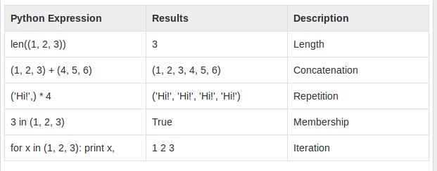
Basic Tuples Operations

Slide 26
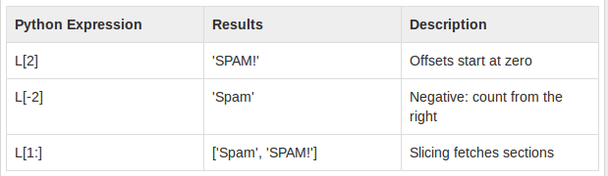
Indexing, Slicing
If L = ('spam', 'Spam', 'SPAM!')

Slide 27
Built-in Tuple Functions
tuple1, tuple2 = (123, 'xyz'), (456, 'abc')
len(tuple1)
2
When we have numerical tuple:
t1 = (1,2,3,7,4)
max(t1) #prints 7
min(t1) #prints 7

Slide 28
Converts a list into a tuple
tuple(seq)
t2=tuple([2,4])
>>> t2
(2, 4)

Slide 29
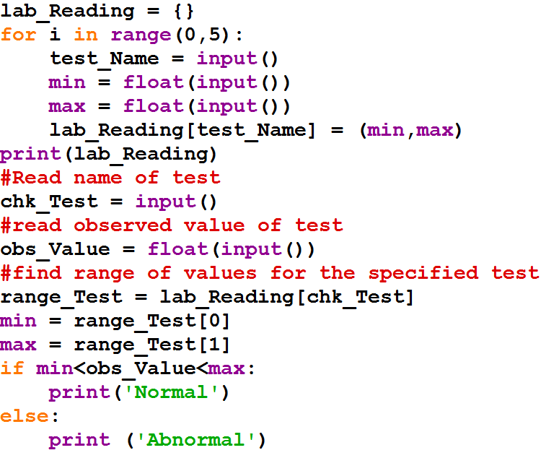

Slide 30
Problem:
An University has published the results of the term end examination conducted in April. List of failures in physics, mathematics, chemistry and computer science is available. Write a program to find the number of failures in the examination. This includes the count of failures in one or more subjects

Slide 31
PAC For University Result Problem
Input | Processing | Output
Read the register number of failures in Maths, Physics, Chemistry and Computer Science | Create a list of register numbers who have failed in one or more subjects Count the count of failures | Print Count

Slide 32
Pseudocode
READ maths_failure, physics_failure, chemistry_failure and cs_failure
Let failure be empty
FOR each item in maths_failure
ADD item to failure
FOR each item in physics_failure
IF item is not in failure THEN
ADD item to failure
END IF
FOR each item in chemistry_failure
IF item is not in failure THEN
ADD item to failure
END IF
FOR each item in cs_failure
IF item is not in failure THEN
ADD item to failure
END IF
SET count = 0
FOR each item in failure
count = count + 1
PRINT count

Slide 33
Sets
an unordered collection of unique and immutable objects that supports operations corresponding to mathematical set theory
Set is mutable
No duplicates
Sets are iterable, can grow and shrink on demand, and may contain a variety of object types
Does not support indexing

Slide 34
x = {1, 2, 3, 4}
y = {'apple','ball','cat'}
x1 = set('spam') # Prepare set from a string
print (x1)
{'s', 'a', 'p', 'm'}
x1.add('alot') # Add an element to the set
print (x1)
{'s', 'a', 'p', 'alot', 'm'}

Slide 35
Set Operations
Let S1 = {1, 2, 3, 4}
Union (|)
S2 = {1, 5, 3, 6} | S1
print(S2) # prints {1, 2, 3, 4, 5, 6}
Intersection (&)
S2 = S1 & {1, 3}
print(S2) # prints {1, 3}

Slide 36
Difference (-)
S2 = S1 - {1, 3, 4}
print(S2) # prints {2}
Super set (>)
S2 = S1 > {1, 3}
print(S2) # prints True
Empty sets must be created with the set built-in, and print the same way

Slide 37
S2 = S1 - {1, 2, 3, 4}
print(S2) # prints set() – Empty set
Empty curly braces represent empty dictionary but not set
In interactive mode – type({}) gives
<class 'dict'>

Slide 38
>>> {1, 2, 3} | {3, 4}
{1, 2, 3, 4}
>>> {1, 2, 3} | [3, 4]
TypeError: unsupported operand type(s) for |: 'set' and 'list'
>>> {1, 2, 3} | set([3, 4]) #Convert list to set and work
{1,2,3,4}

Slide 39
>>> {1, 2, 3}.union([3, 4])
{1,2,3,4}
>>> {1, 2, 3}.union({3, 4})
{1,2,3,4}

Slide 40
Immutable constraints and frozen sets
Can only contain immutable (a.k.a. “hashable”) object types
lists and dictionaries cannot be embedded in sets, but tuples can if you need to store compound values.
Tuples compare by their full values when used in set operations:
>>> S
{1.23}
>>> S.add([1, 2, 3])
TypeError: unhashable type: 'list'

Slide 41
>>> S.add({'a':1})
TypeError: unhashable type: 'dict'
Works for tuples:
>>> S.add((1, 2, 3))
>>> S
{1.23, (1, 2, 3)}

Slide 42
>>> S | {(4, 5, 6), (1, 2, 3)}
{1.23, (4, 5, 6), (1, 2, 3)}
>>> (1, 2, 3) in S # Check for tuple as a whole
True
>>> (1, 4, 3) in S
False

Slide 43
clear()
All elements will removed from a set.
>>> cities = {"Stuttgart", "Konstanz", "Freiburg"}
>>> cities.clear()
>>> cities
set() # empty
>>>

Slide 44
Copy
Creates a shallow copy, which is returned.
>>> more_cities = {"Winterthur","Schaffhausen","St. Gallen"}
>>> cities_backup = more_cities.copy()
>>> more_cities.clear()
>>> cities_backup # copied value is still available
{'St. Gallen', 'Winterthur', 'Schaffhausen‘}

Slide 45
Just in case, you might think, an assignment might be enough:
>>> more_cities = {"Winterthur","Schaffhausen","St. Gallen"}
>>> cities_backup = more_cities #creates alias name
>>> more_cities.clear()
>>> cities_backup
set()
>>>
The assignment "cities_backup = more_cities" just creates a pointer, i.e. another name, to the same data structure.

Slide 46
difference_update()
removes all elements of another set from this set. x.difference_update() is the same as "x = x - y"
>>> x = {"a","b","c","d","e"}
>>> y = {"b","c"}
>>> x.difference_update(y)
>>> x
{'a', 'e', 'd'}

Slide 47
discard(el)
el will be removed from the set, if it is contained in the set and nothing will be done otherwise
>>> x = {"a","b","c","d","e"}
>>> x.discard("a")
>>> x
{'c', 'b', 'e', 'd'}
>>> x.discard("z")
>>> x
{'c', 'b', 'e', 'd'}

Slide 48
remove(el)
works like discard(), but if el is not a member of the set, a KeyError will be raised.
>>> x = {"a","b","c","d","e"}
>>> x.remove("a")
>>> x
{'c', 'b', 'e', 'd'}
>>> x.remove("z")
Traceback (most recent call last):
File "<stdin>", line 1, in <module>
KeyError: 'z’

Slide 49
isdisjoint()
This method returns True if two sets have a null intersection
issubset()
x.issubset(y) returns True, if x is a subset of y
"<=" is an abbreviation for "Subset of" and ">=" for "superset of"
"<" is used to check if a set is a proper subset of a set

Slide 50
issuperset()
x.issuperset(y) returns True, if x is a superset of y. ">=" - abbreviation for "issuperset of“
">" - to check if a set is a proper superset of a set

Slide 51
>>> x = {"a","b","c","d","e"}
>>> y = {"c","d"}
>>> x.issuperset(y)
True

Slide 52
>>> x > y
True
>>> x >= y
True
>>> x >= x
True
>>> x > x
False
>>> x.issuperset(x)
True

Slide 53
>>> x = {"a","b","c","d","e"}
>>> y = {"c","d"}
>>> x.issubset(y)
False
>>> y.issubset(x)
True

Slide 54
>>> x < y
False
>>> y < x # y is a proper subset of x
True
>>> x < x # a set is not a proper subset of oneself.
False
>>> x <= x
True

Slide 55
pop()
pop() removes and returns an arbitrary set element.
The method raises a KeyError if the set is empty
>>> x = {"a","b","c","d","e"}
>>> x.pop()
'a'
>>> x.pop()
'c'

Slide 56
Sets themselves are mutable too, and so cannot be nested in other sets directly;
if you need to store a set inside another set, the frozenset built-in call works just like set but creates an immutable set that cannot change and thus can
be embedded in other sets

Slide 57
To create frozenset:
cities = frozenset(["Frankfurt", "Basel","Freiburg"])
cities.add("Strasbourg") #cannot modify
Traceback (most recent call last):
File "<stdin>", line 1, in <module>
AttributeError: 'frozenset' object has no attribute 'add'

Slide 58
Set comprehensions
run a loop and collect the result of an expression on each iteration
result is a new set you create by running the code, with all the normal set behavior
>>> {x ** 2 for x in [1, 2, 3, 4]}
{16, 1, 4, 9}
>>> {x for x in 'spam'}
{'m', 's', 'p', 'a'}

Slide 59
>>> S = {c * 4 for c in 'spam'}
>>> print(S)
{'pppp','aaaa','ssss', 'mmmm'}
>>>> S = {c * 4 for c in 'spamham'}
{'pppp','aaaa','ssss', 'mmmm','hhhh'}
>>>S | {'mmmm', 'xxxx'}
{'pppp', 'xxxx', 'mmmm', 'aaaa', 'ssss'}
>>> S & {'mmmm', 'xxxx'}
{'mmmm'}

Slide 60
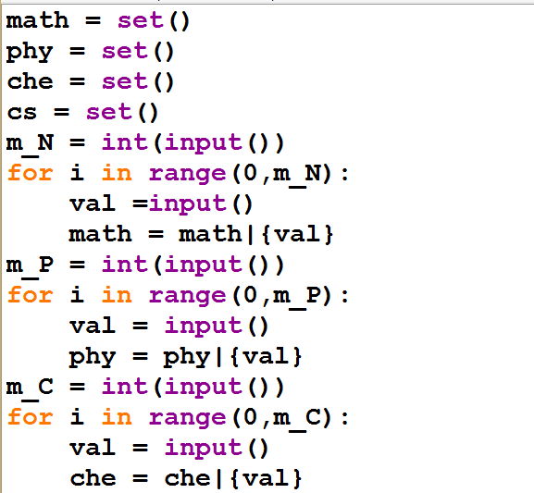

Slide 61
